Slide 1
777 Garfield
Proposed Multi-Generational Development

Slide 2
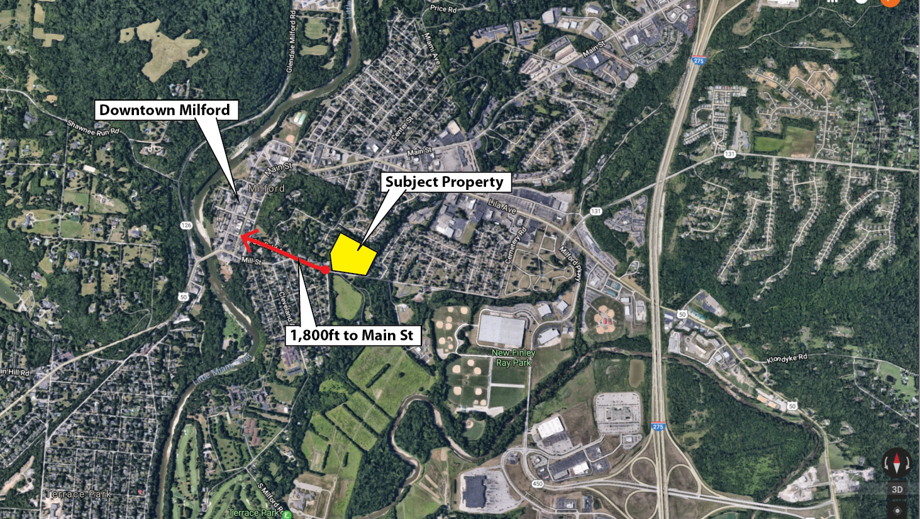
Location

Slide 3
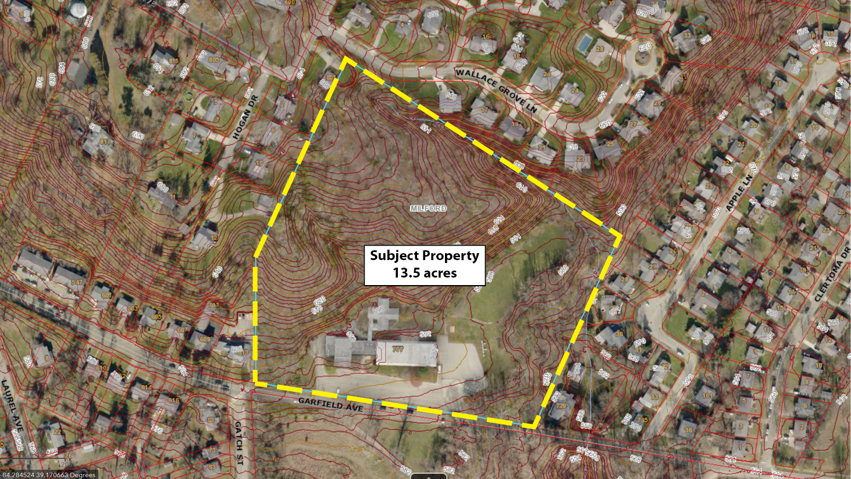
Subject Property - Aerial

Slide 4
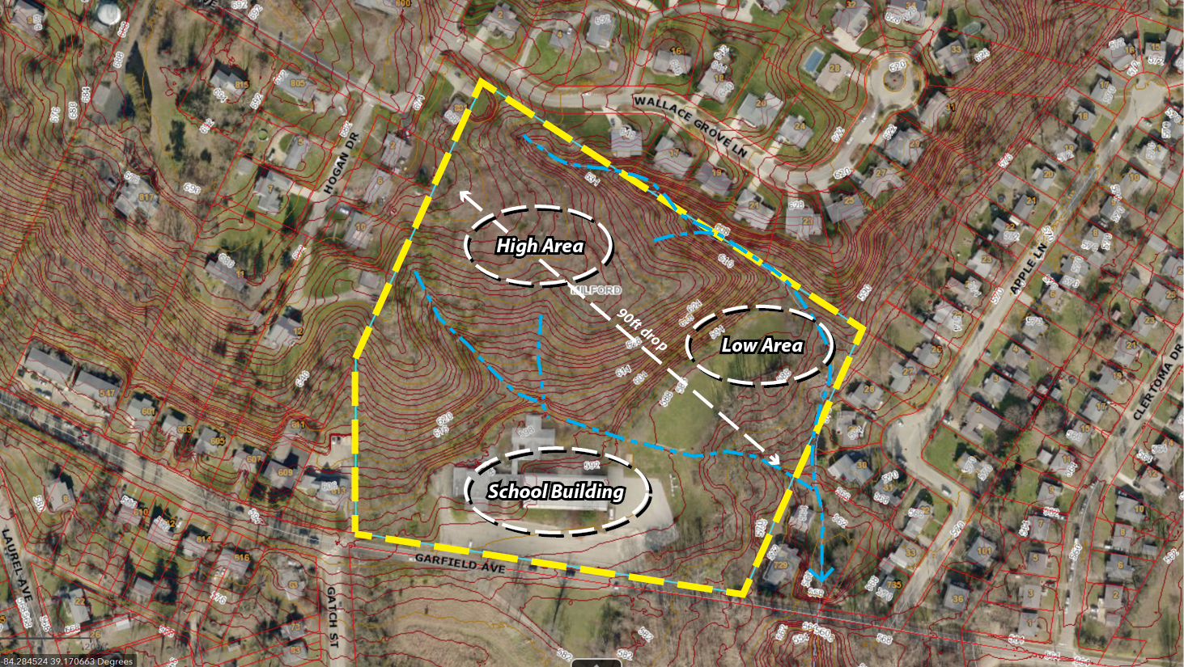
Site Features

Slide 5
Site Challenges / Opportunities
Topography: hillside limits site design by creating a natural separation between high /low areas. This condition provides an opportunity to create a mix of housing types to create a more vibrant /dynamic community.
School Building: environmental issues create significant cost burden to the project. To offset cost, there may exist an opportunity to reuse /repurpose the existing structure to compliment the future development.
Zoning: per ordinance 18-1368, the site was zoned to R2 (Single-Family homes on 10,000sf lots); to create the dynamic mix of housing types mentioned above, the developer may seek a Re-Zone to PD.

Slide 6
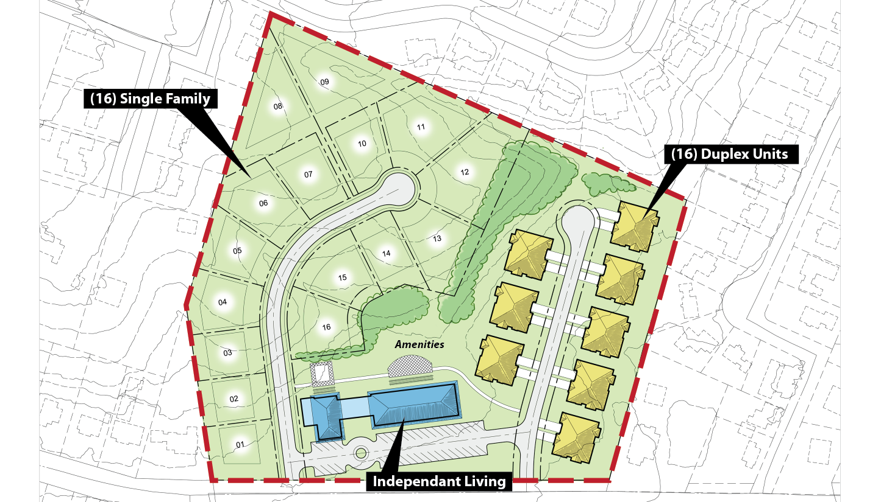
Proposed Development Plan

Slide 7
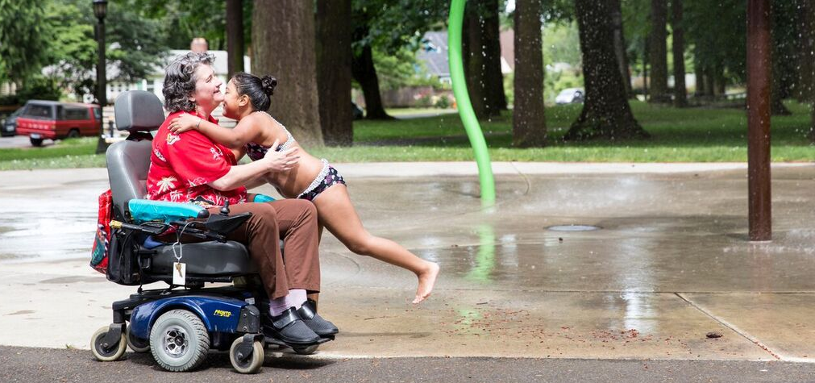
Multi-Generational Issues
Older people, young adults, and families share many important priorities and issues within a community—physically, socially, and culturally. For example, a safe, well-maintained sidewalk benefits seniors desiring exercise or who no longer drive. At the same time it helps a young mother pushing a stroller or a child learning to ride a bicycle.
One problem within communities is that different population groups do not always recognize their reliance on one another. A Cornell University/APA survey of planners found that the biggest barrier to the creation of a family-friendly community is NIMBYism (Israel and Warner 2008). With each age segment defending its perceived narrow position, there are many missed opportunities and wasted resources.
Unfortunately, most programs for the elderly have been built on the notion of age segregation.. Yet recent research by AARP has shown that most aging Americans do not want to live in communities separate from younger people.
Communities built to address the needs of older persons and families are communities that can serve all residents well. Livable communities have physical and social features that benefit people of all ages.

Slide 8
Multi-Generational Case Studies:
Aging in place requires programs that break down age-segregated barriers. Huntington Beach, California, developed a comprehensive plan to transform a 23-acre site originally intended for single-family homes into a multigenerational neighborhood with affordable homes to fit different lifestyles and stages. The Gen M 2345 team, which stands for the multiple (two, three, four, or five) generations that might live together, designed a neighborhood with a mix of town houses and carriage houses that could accommodate home-based businesses and young families, downsizing baby boomers, their aging parents, and their boomerang adult children. The program won the Gold Nugget Award for architectural design excellence in 2009 (www.martin-associates.net).
One example of involving seniors as caregivers in multigenerational planning is collocating child care and elder care. In Ithaca, New York, a local Head Start program is permanently housed at a retirement community. Each week, the seniors work with preschoolers on a variety of activities such as reading, singing, and crafts. The intergenerational program (which includes bowling and a choir with college students) allows older people to participate in the mentorship of younger community members. Studies of such structured interaction between young children and the elderly show children become more helpful, empathize with older people, and develop better self-control as a result (Femia et al. 2008).

Slide 9
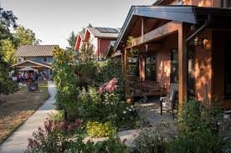
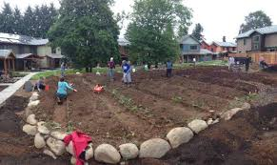
Multi-Generational Case Studies:
But we don’t live in a typical subdivision. Both of our families are part of Cully Grove, a 16-home multigenerational “garden community” in Portland, Oregon. Clustered around a common house, shared gardens, and two courtyards, this 2013 “farm in the city” development contains attached townhomes of about 1,500 square feet each. Residents are just about evenly split between empty nesters and young families – which turns out to be a pretty good mix. Had it been all families, chaos would likely abound. Had there been all seniors except for a couple of young families, there wouldn’t be a critical mass of kid play energy. Now, when our next door neighbors’ grandkids are visiting, they can spend some of their time playing with our toddler—and older daughter when she gets home from school—which works out great for all involved.

Slide 10
Multi-Generational Housing References
“Case Study: Hope Meadows: A Planned Neighborhood of Generations of Hope”
https://academic.oup.com/ppar/article-abstract/19/1/21/1534436?redirectedFrom=PDF#
“The City of 2050 — An Age-Friendly, Vibrant, Intergenerational Community”
https://www.ingentaconnect.com/content/asag/gen/2010/00000034/00000003/art00014
“Friends of all ages: Life in a multigenerational community”
https://www.aia.org/articles/5636-friends-of-all-ages-life-in-a-multigeneration:61
“Strangers Become Family at This Multigenerational Housing Project”
https://www.yesmagazine.org/issues/the-gig-economy/strangers-become-family-at-this-multigenerational-housing-project-20160925
“Building Communities for All Ages: Lessons Learned from an Intergenerational Community‐building Initiative”
https://onlinelibrary.wiley.com/doi/abs/10.1002/casp.2172
“Using Smart Growth and Universal Design to Link the Needs of Children and the Aging Population”
https://www.planning.org/publications/document/9148235/

Slide 11
Next Steps

